Slide 1

Software Design and Architecture [Software Architecture] – Week 03, L02

Slide 2
Lecture Outlines
Software Architecture Process
  Understand and Evaluate Requirements
  Design the Architecture
  Evaluate the Architecture
  Document the Architecture
  Monitor and control implementation
Requirements Engineering
  Elicitation
  Analysis
  Specification
  Validation
What’s next..

Slide 3
Software Architecture Process
On a larger scale, the process for creating software architectures can be executed using the following tasks:
  Understand and evaluate requirements
  Design the architecture
  Evaluate the architecture
  Document the architecture
  Monitor and control implementation

Slide 4
Understand and Evaluate Requirements
Requirements engineering
  The discipline within software engineering that is concerned with the systematic approach to requirements specification, mainly through the following activities:
    Elicitation
    Analysis
    Specification
    Validation
Software architects spend a great deal of time working with software requirements.
  Even after requirements are specified, software architects find themselves going back and forth between requirements and design.
  In some cases, architects are completely immersed in the requirements phase, playing a key role in the specification of requirements.

Slide 5
Understand and Evaluate Requirements (Elicitation)
Elicitation
  Activity that deals with identifying stakeholders, uncovering what the customer needs and wants, and with determining the non-functional requirements.
  Begins by identifying all sources of information that can be used to generate requirements.
  Different sources can have similar but different visions for the system.
    Common sources of requirements include:
      Stakeholders
      Goals
      Domain knowledge
      Operational and organizational environment

Slide 6
Understand and Evaluate Requirements (Elicitation)
Common Elicitation Techniques
  Interviews
  Facilitated meetings
  Observation
  Scenarios

Slide 7
Understand and Evaluate Requirements (Elicitation)
On eliciting requirements using Scenarios
  A popular approach for eliciting requirements.
  Allow designers to present stakeholders with storylines about different behaviors that the system is expected to provide.
  These storylines are born out of the perceived expected behavior and refined and validated through stakeholders’ reviews.
  They provide a valuable means for:
    Establishing a framework for eliciting requirements
    Identifying major system functions and details of the software
    Providing initial insight into the required testing of the software.

Slide 8
Understand and Evaluate Requirements (Elicitation)
In UML, scenarios are grouped by use cases
  For each use case, one or more scenarios
  Since there are no universally accepted method for documenting scenarios, they can be found in the following format:
    Paragraphs, numbered list, tabular or graphical form, etc.
  Without scenarios, use cases provide limited benefits.

Slide 9
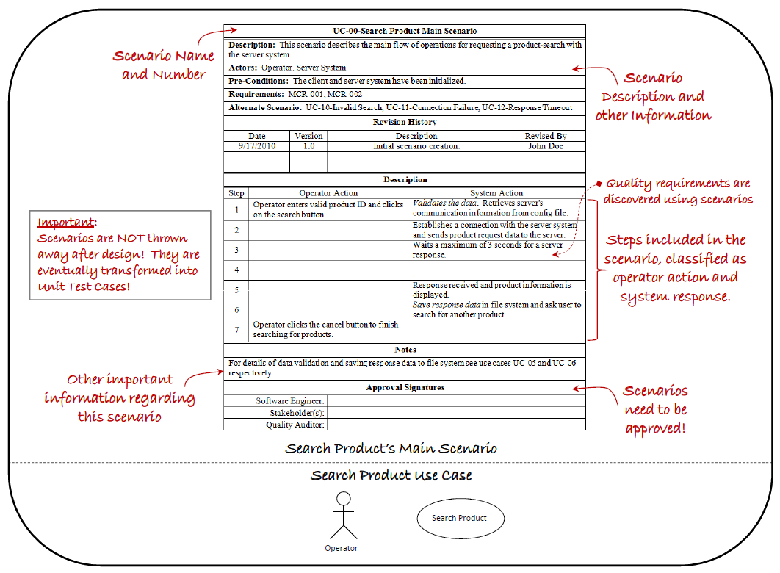
A use case scenario example

Slide 10
Understand and Evaluate Requirements (Analysis)
Analysis
  Requirements are analyzed in their raw form to address issues such as requirements that are contradicting, incomplete, vague, or just wrong.
  Allows architects to clear the air in regard to what needs to be done before devising more detailed designs.
  The following tasks can be performed during analysis:
    Requirement classification
    Requirement prioritization
    Requirement negotiation
    Conceptual modeling

Slide 11
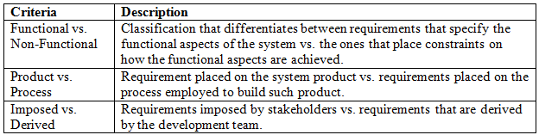
Understand and Evaluate Requirements (Analysis)
Requirement classification
  Performed for identifying the nature of each requirement
    Functional vs. non-functional
    Product vs. process
    Imposed vs. derived

Slide 12
Understand and Evaluate Requirements (Analysis)
Requirement prioritization and negotiation
  Helps identify the most important functions of the software system.
  When done properly, it can help refine the projected schedule by determining which requirements need to be processed first.
  Can be used to determine different builds of the software
  Can help during negotiation when conflicts between requirements are identified

Slide 13
Understand and Evaluate Requirements (Analysis)
Conceptual modeling
  Conceptual models are created to further identify the requirements by understanding their context, discovering the bounds of the software system, and conceptualizing how the system interacts with its environment.
  In many projects, this is where architectural design begins, since system decomposition is essential to developing effective conceptual models. (important)

Slide 14
Understand and Evaluate Requirements
(Specification & validation)
Specification and validation
  Activity where the results of elicitation an analysis are formally captured and documented in an appropriate format for the use and review of all stakeholders.
  When specifying requirements, it is important that each requirement exhibit certain characteristics desired for designing successful systems. Requirements must be:
Specific | Consistent
Correct | Attainable
Complete | Verifiable

Slide 15
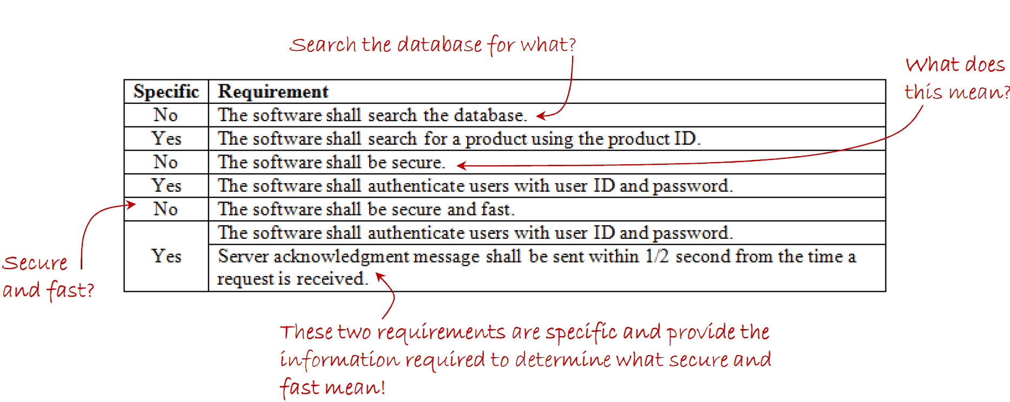
Understand and Evaluate Requirements
On being specific,
  Requirements need to be specified in a clear, concise, and exclusive manner.
  Clear requirements are not open to interpretation; unclear or ambiguous requirements lead to incorrect designs, incorrect implementations, and deceptive validation during test.
  Concise requirements are brief and to the point and are therefore easier to understand.
  Exclusive requirements specify one, and only one thing, making them easier to verify.
Example of specific and nonspecific requirements:

Slide 16
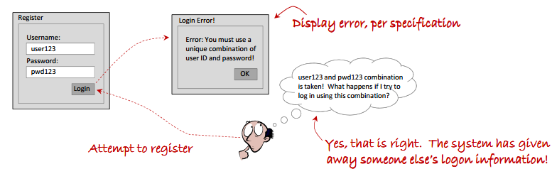
Understand and Evaluate Requirements
On being correct,
  Requirements need to be correct in the sense that they must accurately describe a desired system function.
  Incorrect requirements can lead to incorrect or undesired behavior.

Slide 17
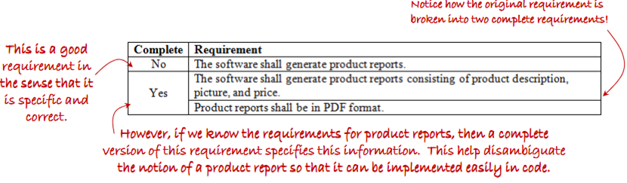
Understand and Evaluate Requirements
On being complete,
  Requirements must be complete both individually and as collective set.
    This means that each requirement should be specified thoroughly so that it absolutely describes the functions required to meet some need.
    Collectively, requirements need to provide complete specification of the software’s required functionality in the software requirements specification (SRS).
  Incomplete requirements lead to incomplete designs, which in turn leads to incomplete construction of the software system.

Slide 18

Understand and Evaluate Requirements
On being consistent,
  Requirements are consistent when they do not preclude the design or construction of other requirements.
On being attainable,
  Requirements that are unattainable serve no purpose.
  Attainability can be determined for both product and process.

Slide 19

Understand and Evaluate Requirements
On being verifiable,
  Perhaps the most obvious desirable characteristic of requirements.
  Requirements that cannot be verified cannot be claimed as met.
  Inability to verify requirements point to a serious flaw early on in the development process

Slide 20
Summary
In this session, we presented fundamentals concepts of requirements engineering, and provided enough information to successfully create good requirements.
In the next session, we’ll discuss how to design the software architecture using the popular 4+1 View Model, which includes:
  Logical view
  Development View
  Process View
  Physical View
  User View

